Slide 1

Android Development
SAX/XML parsing
Links for Final Project ideas!
Demos
-Login Screen

Slide 2
Introduction to XML
Review of XML
What is different about XML parsing?
Simple Example program

Slide 3
Introduction to parsers
The word parser comes from compilers
In a compiler, a parser is the module that reads and interprets the programming language.

Slide 4
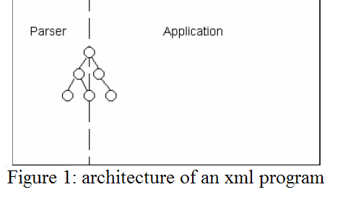
Introduction to Parsers
In XML, a parser is a software component that sits between the application and the XML files.

Slide 5
Introduction to parsers
It reads a text-formatted XML file or stream and converts it to a document to be manipulated by the application.

Slide 6
Well-formedness and validity
Well-formed documents respect the syntactic rules.
Valid documents not only respect the syntactic rules but also conform to a structure as described in a DTD.

Slide 7
Validating vs. Non-validating parsers
Both parsers enforce syntactic rules
only validating parsers know how to validate documents against their DTDs

Slide 8
What is DOM?
The Document Object Model (DOM) is an application programming interface (API) for HTML and XML documents.
It defines the logical structure of documents and the way a document is accessed and manipulated

Slide 9
Properties of DOM
Programmers can build documents, navigate their structure, and add, modify, or delete elements and content.
Provides a standard programming interface that can be used in a wide variety of environments and applications.
structural isomorphism.

Slide 10
DOM Identifies
The interfaces and objects used to represent and manipulate a document.
The semantics of these interfaces and objects - including both behavior and attributes.
The relationships and collaborations among these interfaces and objects.

Slide 11
DOM into work
<?xml version="1.0"?>
<products>
<product>
<name>XML Editor</name>
<price>499.00</price>
</product>
<product>
<name>DTD Editor</name>
<price>199.00</price>
</product>
<product>
<name>XML Book</name>
<price>19.99</price>
</product>
<product>
<name>XML Training</name>
<price>699.00</price>
</product>
</products>

Slide 12
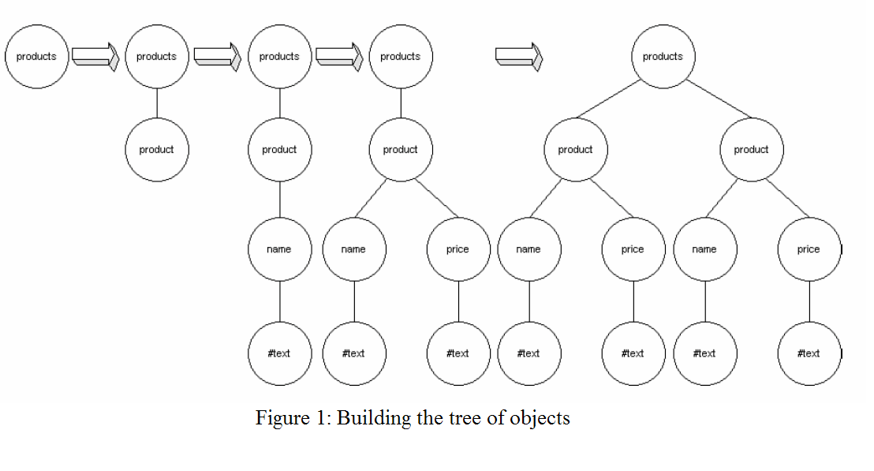
DOM into work

Slide 13
Quick XML Review
XML – Wave of the future
Method of representing data
Differs from HTML by storing and representing data instead of displaying or formatting data
Tags similar to HTML tags, only they are user-defined
Follows a small set of basic rules
Stored as a simple ASCII text file, so portability is insanely easy

Slide 14
Quick XML Review
Syntax
Every XML document has a preamble
<?xml version=“1.0” ?>
An XML document may or may not have a DTD (Document Type Definition) or Schema
<!DOCTYPE catalog>

Slide 15
Quick XML Review
Syntax cont.
Every element has a start and end tag, with optional attributes
<catalog version=“1.0”> … </catalog>
If an element does not contain any data (or elements) nested within, the closing tag can be merged with the start tag like so:
<catalog version=“1.0”/>

Slide 16
Quick XML Review
Syntax cont.
Elements must be properly nested
The outermost element is called the root element
An XML document that follows the basic syntax rules is called well-formed
An XML document that is well-formed and conforms to a DTD or Schema is called valid
Once again, XML documents do not always require a DTD or Schema, but they must be well-formed

Slide 17
Quick XML Review
Sample XML files
Catalog.xml

Slide 18
Catlog.xml
<?xml version="1.0"?>
<catalog library="somewhere">
<book>
<author>John Doe</author>
<title>Title 1</title>
</book>
<book>
<author>Phill Smith</author>
<title>His One Book</title>
</book>
<magazine>
<name>PC Mag</name>
<article page="17">
<headline>Second Headline</headline>
</article>
</magazine>
</catalog>

Slide 19
What is XML Parser?
A program or module that checks a well-formed syntax and provides a capability to manipulate XML data elements.
Navigate thru the XML document (DOM or SAX)
extract or query data elements
Add/delete/modify data elements

Slide 20
XML Parsing
DOM (Document Object Model).
Reads the whole document and builds DOM tree.
Simple API for XML = SAX
SAX is an event-based parsing method
reads an XML document, firing (or calling) callback methods when certain events are found (e.g. elements, attributes, start/end tags, etc.)
Pull parser (fast parsing available over SAX!!)

Slide 21
What is SAX (revisited)?
SAX (the Simple API for XML) is an event-based parser for xml documents.
The parser tells the application what is in the document by notifying the application of a stream of parsing events.
Application then processes those events to act on data.

Slide 22
SAX History
SAX 1.0 was released on May 11, 1998.
SAX is a common, event-based API for parsing XML documents, developed as a collaborative project of the members of the XML-DEV

Slide 23
Why SAX?
For applications that are not so XML-centric, an object-based interface is less appealing.
Efficiency: lower level than object-based interfaces

Slide 24
Why SAX?
Event-based interface consumes fewer resources than an object-based one
With an event-based interface, the application can start processing the document as the parser is reading it

Slide 25
Limitations of SAX
With SAX, it is not possible to navigate through the document as you can with a DOM.
The application must explicitly buffer those events it is interested in.

Slide 26
SAX API
Parser events are similar to user-interface events such as ONCLICK (in a browser) or AWT events (in Java).
Events alert the application that something happened and the application might want to react.

Slide 27
SAX API
Element opening tags
Element closing tags
Content of elements
Entities
Parsing errors

Slide 28
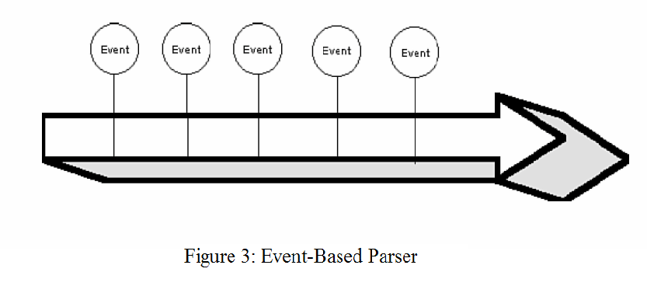
SAX API

Slide 29
SAX Example
<?xml version="1.0"?>
<doc>
<para>Hello, world!</para>
</doc>

Slide 30
SAX example
start document
start element: doc
start element: para
characters: Hello, world!
end element: para
end element: doc
end document

Slide 31
DOM vs. SAX Parsing?
Unlike DOM (Document Object Model), SAX does not store information in an internal tree structure
Because of this, SAX is able to parse huge documents (think gigabytes) without having to allocate large amounts of system resources
Really great if the amount of data you’re looking to process is relatively large (no waste of memory on tree)
If processing is built as a pipeline, you don’t have to wait for the data to be converted to an object; you can go to the next process once it clears the preceding callback method

Slide 32
DOM vs. SAX Parsing?
Most limitations are the programmer’s problem, not the API’s
SAX does not allow random access to the file; it proceeds in a single pass, firing events as it goes

Slide 33
Final project thoughts?
http://sparkster.hubpages.com/hub/How-To-Upload-Android-Apps-For-Free
https://support.google.com/googleplay/android-developer/?hl=en&rd=1#topic=3450769
http://www.apple.com/ios/whats-new/
http://developer.android.com/support.html

Slide 34
Final project thoughts?
https://www.android.com/intl/en_id/
http://www.androidpit.com/en/android/forum/category/1004010/Android-Developer-Forum

Slide 35
Final project thoughts?
http://gethuman.com/phone-number/Google-Play/
Too Viral to handle???
http://www.cnn.com/2014/02/09/tech/flappy-bird-removed-from-app-stores/

